Slide 1

CST 3340
BUSINESS INTELLIGENCE
Coursework 2
Huda Inayatullah Shaikh
M00794693
Notes:
Hii everyone this is Huda Shaikh, today im going to discuss about the dataset that I have worked on for my 2nd Coursework. I would to thankyou for giving me this opportunity to put forwards of my findings at the end of this ppt.

Slide 2
Agenda
01
Introduction to Data Set
02
Data Analysis & Visualization
03
Data Mining
04
Conclusion
Huda Inayatullah Shaikh ; M00794693
Page 2
Notes:
Soo the main agendas for the ppt is to introduce about the dataset, data analysis & visualization with the help of data pre processing, tableau and weka. Also im going to talk about the selection of data mining algorithm that has suited best for my dataset.

Slide 3
Introduction to Data Set
Survival
Data Set Overview
Dr. Elvin Kenny collected the medical records of 132 patients at The Reed Institution, which make up the echocardiogram dataset.
The data is to classify whether the will survive for at least one year after a heart attack.
This dataset includes information on patients who underwent echocardiography, a diagnostic procedure that uses ultrasound waves to create images of the heart.
Age at Heart Attack
Pericardial Effusions
Fractional Shortening
Alive-at-1
Huda Inayatullah Shaikh ; M00794693
Page 3
Notes:
the dataset includes information on patients who underwent echocardiography, a diagnostic procedure that uses ultrasound waves to create images of the heart.
The dataset contains ten features, including E-point septal separation and Left ventricular end-diastolic dimensions, that provide clinical information on the heart patients.
The aim is to predict whether a patient will live for at least one year after a heart attack using other available data. This analysis helps determine the most critical factors that impact a patient's health and assess the likelihood of surviving cardiac failure.

Slide 4
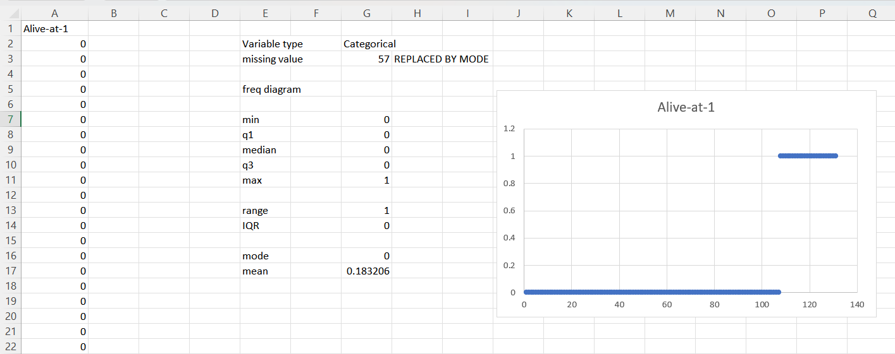
Data Analysis & Visualization
Data Cleaning Process
Data cleaning is an essential step in the data analysis process, as it helps ensure that the dataset is accurate and reliable, which can improve the effectiveness of any subsequent analysis or modeling.
Data profiling: This involves analyzing the dataset to identify the type, format, and range of values in each column or attribute.
Handling missing values: Missing data points need to be addressed, as they can skew the analysis. Various techniques such as imputation, deletion, or estimation can be used to fill in missing values.
Removing duplicates: Duplicate data points should be identified and removed from the dataset.
Handling outliers: Outliers are data points that lie far away from the normal range of values. These data points can be corrected or removed, depending on their impact on the analysis.
Data transformation: This involves converting data into a format suitable for analysis, such as converting categorical data into numerical data.
Huda Inayatullah Shaikh ; M00794693
Page 4
Notes:
Data cleaning process is one the essential step to analysis a raw dataset. Here in the picture above is from my dataset preprocessing, to clean the data I have identified the variable type of each attribute i.e categorical and numerical set of my dataset and calculated the frequency diagram minimum, quartile 1 and 3, median , maximum , mode and mean , range iqr.
The data was analyzed using various techniques such as descriptive statistics, correlation analysis, and clustering. Several visualizations such as histograms, box plots, and scatter plots were used to gain insights into the data, identify trends, and detect outliers.

Slide 5
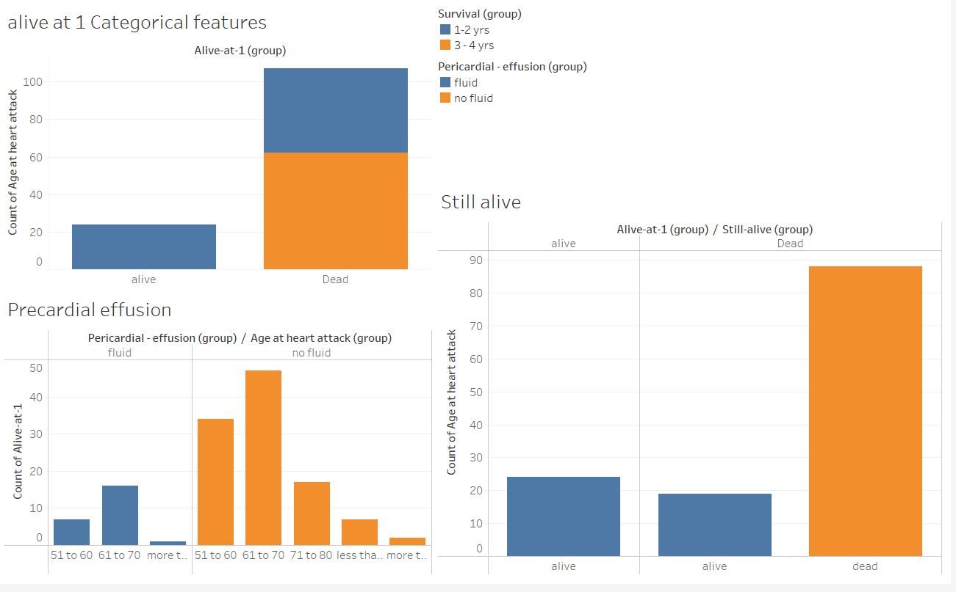
Data Visualization with Tableau
Visualizations with Tableau
Visualizing a dataset through maps, charts, or graphs helps in interpreting and analyzing data effectively by identifying trends, patterns, and associations. It is an important stage in data analysis as it helps derive insights not apparent from the raw data alone.
Huda Inayatullah Shaikh ; M00794693
Page 5
Notes:
Different visualization approaches are used based on the type of information and insights needed. For instance, bar charts, line graphs, and pie charts are used for categorical data, while scatterplots, heat maps, and graphs with bubbles are used to show the relationship between variables.
Tableau Software, a user-friendly and interactive business intelligence platform, allows users to connect, view, and exchange data. It offers a variety of data analysis and visualization tools that may be used by experts from many industries, such as data analysts, business analysts, and students.

Slide 6
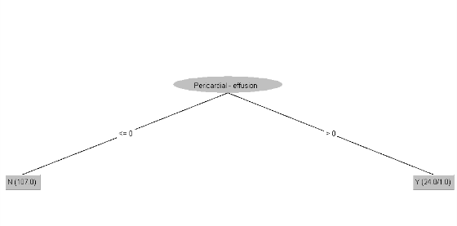
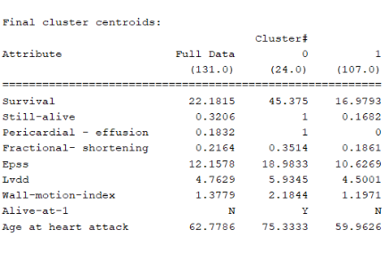
Data Mining
Points considered while selecting data mining algorithm
Information type
Results accuracy
Complication of advancement
Amount of Data Analysis of goals
 | Clustering – K Means
 | J48 Pruned tree
A J48 pruned tree is a decision tree created using the J48 algorithm with pruning enabled. The pruning procedure removes unnecessary branches from the tree that do not significantly contribute to its accuracy, reducing its complexity and improving its generalization on fresh data by reducing overfitting. In the context of the echocardiography dataset, a pruned decision tree using J48 can help identify the most critical features for categorizing patients and predicting their survival after a heart attack.
Clustering is essentially an unsupervised learning strategy. Unsupervised learning is a method that draws references from datasets of input data without labelled answers.
In the instance of an Echocardiogram dataset, clustering may be utilised to assess whether the patients were alive more than a year after their heart attack or not. Clustering can be especially beneficial in finding individuals with similar cardiac features in the case of an echocardiography dataset.
Huda Inayatullah Shaikh ; M00794693
Page 6
Notes:
The choice of information mining calculations is influenced by both the unique task and the dataset. Consider the following while selecting information mining calculations:
Information type: Different information mining techniques are developed to work with various information types
Amount of Data : While certain information mining algorithms are better suited for massive datasets, others do far better with smaller datasets
Analysis of goals: When it comes to exactness, the exactness of various information mining methodologies varies.
Results accuracy: Specific information mining approaches give results that are easier to obtain than others.
Complication of advancement: Different computations have different use requirements. Which increases the challenges in a dataset

Slide 7
Conclusion
The echocardiogram dataset, a pruned decision tree built using J48 and KMeans clustering, can help differentiate the most important features for categorising patients with heart issues and whether they are dead or alive after a certain time period.
The data was analyzed using various techniques such as descriptive statistics, correlation analysis, and clustering. Several visualizations such as histograms, box plots, and scatter plots were used to gain insights into the data, identify trends, and detect outliers.
It can also help in providing insights into the patient population being served.
Huda Inayatullah Shaikh ; M00794693
Page 7
Notes:
BI derived from echocardiography datasets can provide useful insights into patients' cardiovascular health, which can be utilised to enhance patient outcomes and influence clinical decision-making like identifying trends and patterns of in cardiovascular health of information, keep details about the high and low level of epss, lvdd, pericardial effusion of the patients. It can also help in providing insights into the patient population being served. These results can also help in evaluating the effectiveness of different treatments and interventions for cardiac diseases.

